Slide 1
log₁₀(p+1)
 | South | North | East
West | 0.8391 | 0.1049 | 0.0000
South |  | 0.3701 | 0.0005
Noth |  |  | 0.0692

Slide 2
log₁₀(p+1)
 | Medium | Strong
Calm | 0.18 | 0.42
Medium |  | 0.47

Slide 3
log₁₀(p+1)
 | Ponce | Isabella | Luquillo | Culebra | Guayama | Ceiba | Guanica
Rincon | 0.0068 | 0.0098 | 0.0385 | 0.0001 | 0.0000 | 0.0042 | 0.4360
Ponce |  | 0.9845 | 0.0325 | 0.0006 | 0.0055 | 0.0089 | 0.0487
Isabella |  |  | 0.0300 | 0.0002 | 0.0011 | 0.0038 | 0.0802
Luquillo |  |  |  | 0.1829 | 0.0000 | 0.3265 | 0.2671
Culebra |  |  |  |  | 0.0000 | 0.5091 | 0.0013
Guayama |  |  |  |  |  | 0.0091 | 0.0000
Ceiba |  |  |  |  |  |  | 0.0256

Slide 4
log₁₀(p+1)
 | Medium | Large
small | 0.0017 | 0.7097
medium |  | 0.0000

Slide 5
log₁₀(p+1)
 |  | Two | TwoPointFive | Three | ThreePointFive | FourPointFive
OnePointFive |  | 0.0000 | 0.0000 | 0.0000 | 0.0003 | 0.0000
Two |  |  | 0.0044 | 0.0059 | 0.0077 | 0.5073
TwoPointFive |  |  |  | 0.9419 | 0.0000 | 0.0000
Three |  |  |  |  | 0.0000 | 0.0000
ThreePointFive |  |  |  |  |  | 0.0002

Slide 7


Slide 8
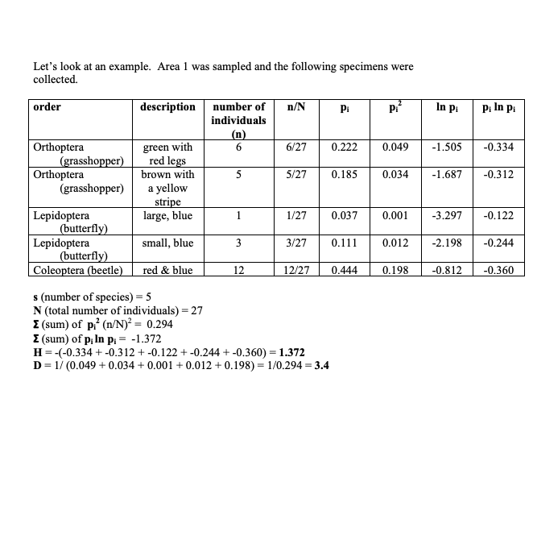

Slide 9
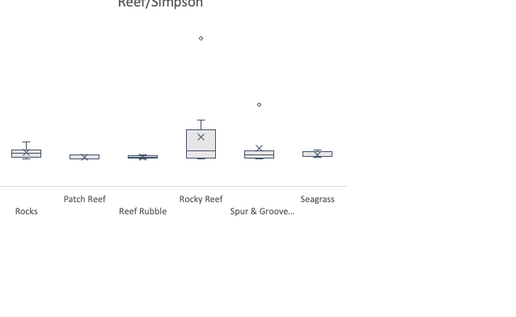
Anova: Single Factor
SUMMARY
Groups | Count | Sum | Average | Variance
Patch Reef | 7 | 7.02092662 | 1.00298952 | 1.3957E-05
Reef Rubble | 6 | 6.01672765 | 1.00278794 | 5.3623E-06
Rocks | 8 | 8.08962073 | 1.01120259 | 9.8488E-05
Rocky Reef | 10 | 10.3886755 | 1.03886755 | 0.00443554
Seagrass | 5 | 5.0359523 | 1.00719046 | 2.5493E-05
Spur & Groove Reef | 7 | 7.13324387 | 1.01903484 | 0.00120438
ANOVA
Source of Variation | SS | df | MS | F | P-value | F crit
Between Groups | 0.00809795 | 5 | 0.00161959 | 1.2471845 | 0.30719821 | 2.46964965
Within Groups | 0.04804809 | 37 | 0.0012986
Total | 0.05614604 | 42

Slide 10
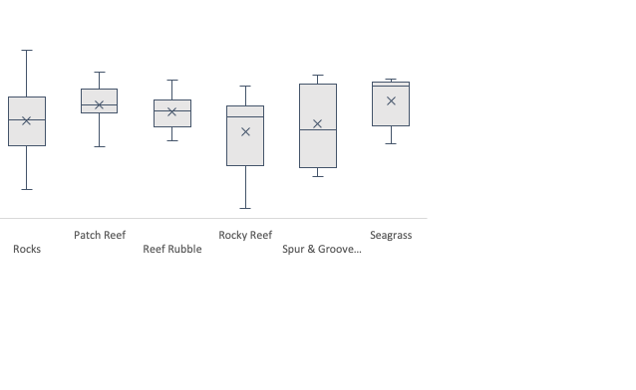
SUMMARY
Groups | Count | Sum | Average | Variance
Patch Reef | 7 | 58.7736585 | 8.39623693 | 0.08020845
Reef Rubble | 6 | 49.8599861 | 8.30999768 | 0.06109459
Rocks | 8 | 65.5559367 | 8.19449208 | 0.25223231
Rocky Reef | 10 | 80.6034141 | 8.06034141 | 0.24044432
Seagrass | 5 | 42.2366192 | 8.44732384 | 0.10618252
Spur & Groove Reef | 7 | 57.1300458 | 8.16143511 | 0.25307954
ANOVA
Source of Variation | SS | df | MS | F | P-value | F crit
Between Groups | 0.79713285 | 5 | 0.15942657 | 0.88576222 | 0.5003934 | 2.46964965
Within Groups | 6.65955598 | 37 | 0.179988
Total | 7.45668883 | 42

Slide 11
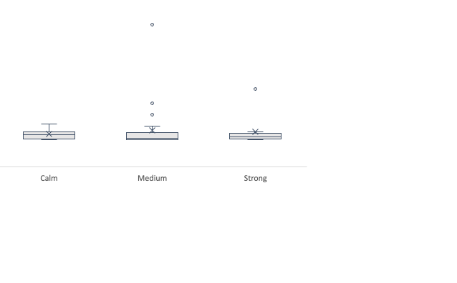
SUMMARY
Groups | Count | Sum | Average | Variance
Calm | 8 | 8.08962073 | 1.01120259 | 9.8488E-05
Medium | 25 | 25.4444868 | 1.01777947 | 0.00198217
Strong | 10 | 10.1510392 | 1.01510392 | 0.00084595
ANOVA
Source of Variation | SS | df | MS | F | P-value | F crit
Between Groups | 0.00027112 | 2 | 0.00013556 | 0.09704683 | 0.90772652 | 3.23172699
Within Groups | 0.05587492 | 40 | 0.00139687
Total | 0.05614604 | 42

Slide 12
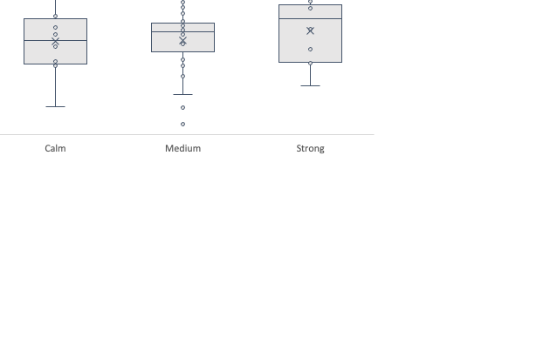
SUMMARY
Groups | Count | Sum | Average | Variance
Calm | 8 | 65.5559367 | 8.19449208 | 0.25223231
Medium | 25 | 205.298855 | 8.2119542 | 0.16995951
Strong | 10 | 83.3048688 | 8.33048688 | 0.16605795
ANOVA
Source of Variation | SS | df | MS | F | P-value | F crit
Between Groups | 0.11751281 | 2 | 0.0587564 | 0.32023433 | 0.72782283 | 3.23172699
Within Groups | 7.33917602 | 40 | 0.1834794
Total | 7.45668883 | 42

Slide 13
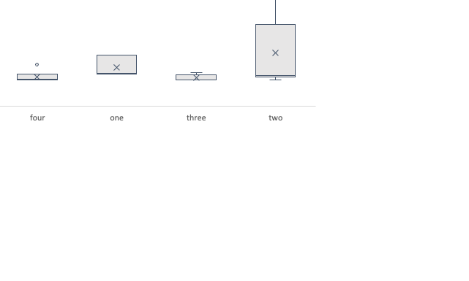
SUMMARY
Groups | Count | Sum | Average | Variance
one | 3 | 3.07112419 | 1.02370806 | 0.00041288
two | 6 | 6.30984978 | 1.05164163 | 0.00719177
three | 5 | 5.02017318 | 1.00403464 | 4.1204E-05
four | 6 | 6.03687736 | 1.00614623 | 0.00014005
ANOVA
Source of Variation | SS | df | MS | F | P-value | F crit
Between Groups | 0.00840214 | 3 | 0.00280071 | 1.19021974 | 0.34492726 | 3.23887152
Within Groups | 0.03764969 | 16 | 0.00235311
Total | 0.04605183 | 19

Slide 14
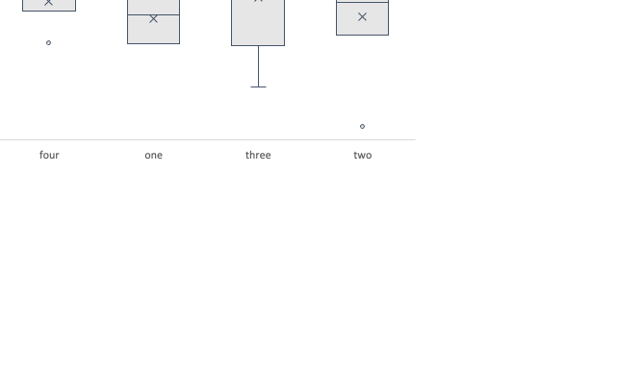
SUMMARY
Groups | Count | Sum | Average | Variance
one | 3 | 24.5178844 | 8.17262812 | 0.05243057
two | 6 | 49.1065852 | 8.18443087 | 0.28110686
three | 5 | 41.8533935 | 8.3706787 | 0.26413591
four | 6 | 50.0268892 | 8.33781487 | 0.0501093
ANOVA
Source of Variation | SS | df | MS | F | P-value | F crit
Between Groups | 0.15010181 | 3 | 0.05003394 | 0.28413382 | 0.8361136 | 3.23887152
Within Groups | 2.81748561 | 16 | 0.17609285
Total | 2.96758742 | 19

Slide 15
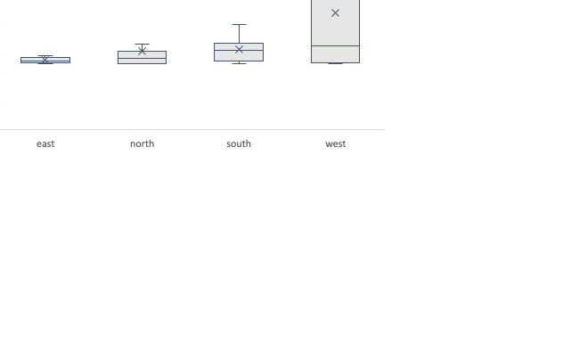
SUMMARY
Groups | Count | Sum | Average | Variance
east | 6 | 6.01672765 | 1.00278794 | 5.3623E-06
north | 19 | 19.1901228 | 1.01000646 | 0.00046483
south | 8 | 8.08962073 | 1.01120259 | 9.8488E-05
west | 10 | 10.3886755 | 1.03886755 | 0.00443554
ANOVA
Source of Variation | SS | df | MS | F | P-value | F crit
Between Groups | 0.00714306 | 3 | 0.00238102 | 1.89498149 | 0.14640524 | 2.84506781
Within Groups | 0.04900298 | 39 | 0.00125649
Total | 0.05614604 | 42

Slide 16
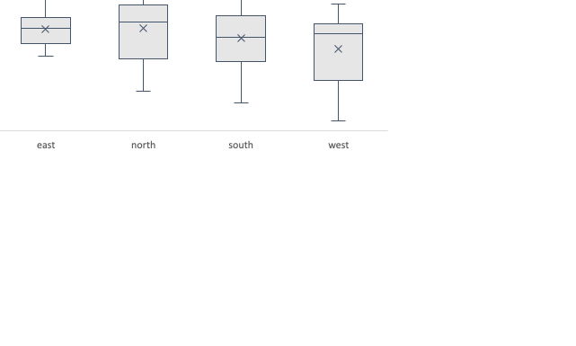
SUMMARY
Groups | Count | Sum | Average | Variance
east | 6 | 49.8599861 | 8.30999768 | 0.06109459
north | 19 | 158.140324 | 8.32317492 | 0.15122264
south | 8 | 65.5559367 | 8.19449208 | 0.25223231
west | 10 | 80.6034141 | 8.06034141 | 0.24044432
ANOVA
Source of Variation | SS | df | MS | F | P-value | F crit
Between Groups | 0.49958331 | 3 | 0.16652777 | 0.93351797 | 0.43369438 | 2.84506781
Within Groups | 6.95710552 | 39 | 0.17838732
Total | 7.45668883 | 42

Slide 17
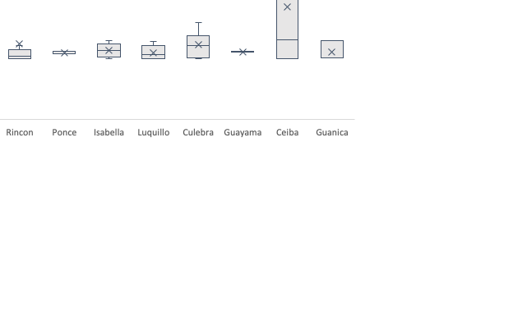
SUMMARY
Groups | Count | Sum | Average | Variance
Ceiba | 8 | 8.37228357 | 1.04653545 | 0.0053547
Culebra | 6 | 6.06945028 | 1.01157505 | 0.00012468
Guanica | 3 | 3.01639191 | 1.00546397 | 6.4944E-05
Guayama | 2 | 2.01171829 | 1.00585914 | 3.1158E-07
Isabella | 5 | 5.03432719 | 1.00686544 | 3.3905E-05
Luquillo | 5 | 5.02483655 | 1.00496731 | 3.7371E-05
Ponce | 3 | 3.01494899 | 1.004983 | 1.7559E-06
Rincon | 10 | 10.1253016 | 1.01253016 | 0.00088837
ANOVA
Source of Variation | SS | df | MS | F | P-value | F crit
Between Groups | 0.00962563 | 7 | 0.00137509 | 1.00500123 | 0.44494662 | 2.29383216
Within Groups | 0.04652041 | 34 | 0.00136825
Total | 0.05614604 | 41

Slide 18
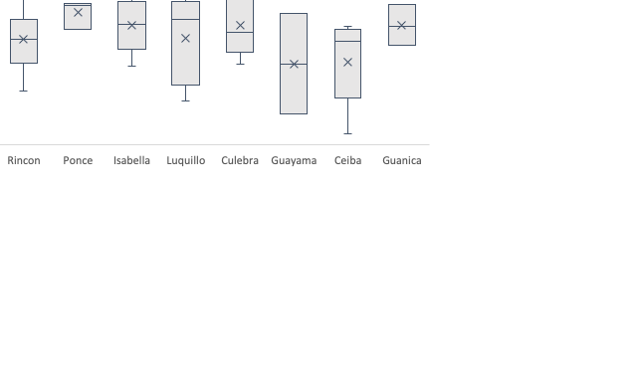
SUMMARY
Groups | Count | Sum | Average | Variance
Ceiba | 9 | 71.6820385 | 7.96467094 | 0.22103027
Culebra | 6 | 50.3518771 | 8.39197951 | 0.15595267
Guanica | 3 | 25.1793214 | 8.39310712 | 0.05410788
Guayama | 2 | 15.8847618 | 7.9423809 | 0.68030581
Isabella | 5 | 41.960874 | 8.3921748 | 0.09752151
Luquillo | 5 | 41.1940114 | 8.23880229 | 0.27787193
Ponce | 3 | 25.6305145 | 8.54350482 | 0.02841166
Rincon | 10 | 82.2762617 | 8.22762617 | 0.12226353
ANOVA
Source of Variation | SS | df | MS | F | P-value | F crit
Between Groups | 1.46139286 | 7 | 0.20877041 | 1.21878291 | 0.31875825 | 2.28523517
Within Groups | 5.99529597 | 35 | 0.17129417
Total | 7.45668883 | 42

Slide 19
Metsalu, Tauno and Vilo, Jaak. Clustvis: a web tool for visualizing clustering of multivariate data using Principal Component Analysis and heatmap. Nucleic Acids Research, 43(W1):W566–W570, 2015. doi: 10.1093/nar/gkv468.
Notes:
Principal component analysis

Slide 20
Metsalu, Tauno and Vilo, Jaak. Clustvis: a web tool for visualizing clustering of multivariate data using Principal Component Analysis and heatmap. Nucleic Acids Research, 43(W1):W566–W570, 2015. doi: 10.1093/nar/gkv468.

